Slide 1
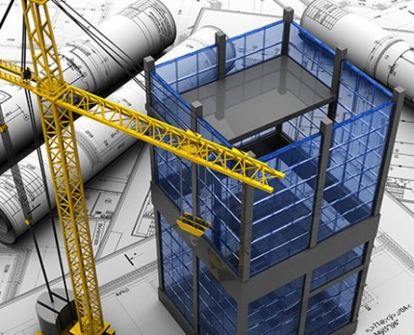
Analysis & design of
An-Najah National University mosque
Under supervision of: Dr. Mohammad Samaaneh
Prepared by:
Aref Shehab
Fawzi Al-Asaad
Murad Abdul-Halim
Notes:
NOTE:
To change the image on this slide, select the picture and delete it. Then click the Pictures icon in the placeholder to insert your own image.

Slide 2
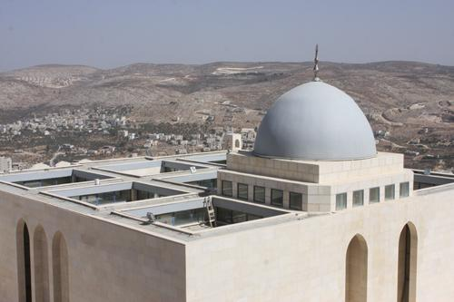
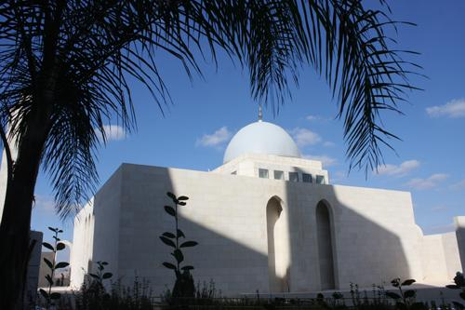
OUTLINE
2134 m2

Slide 3
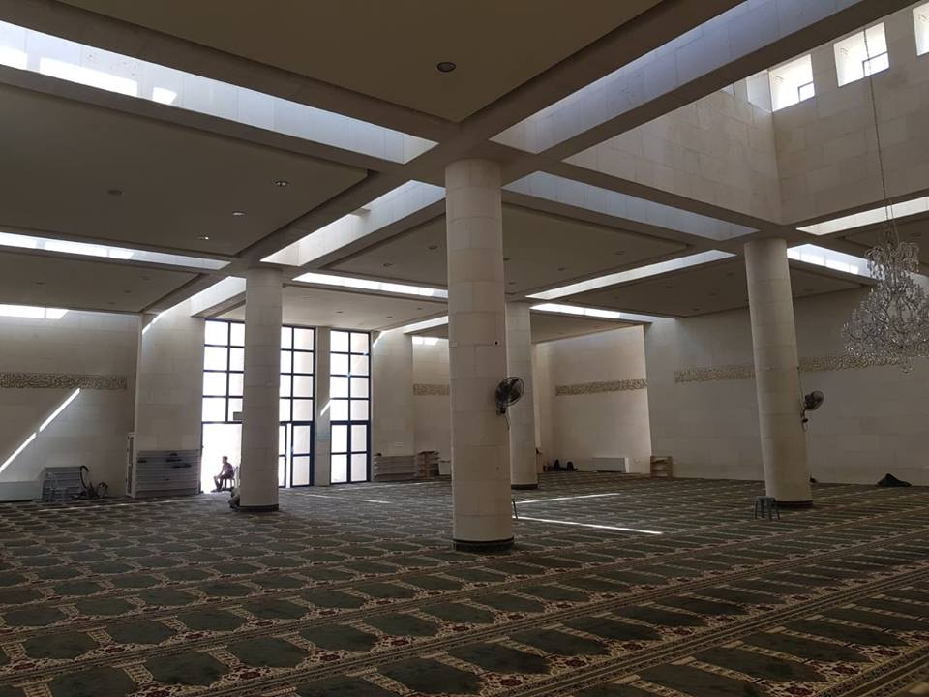
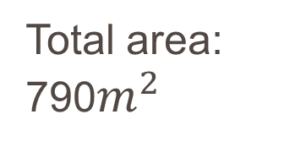
Ground floor: Male mosque.
Total area:
790$m^{2}$

Slide 4
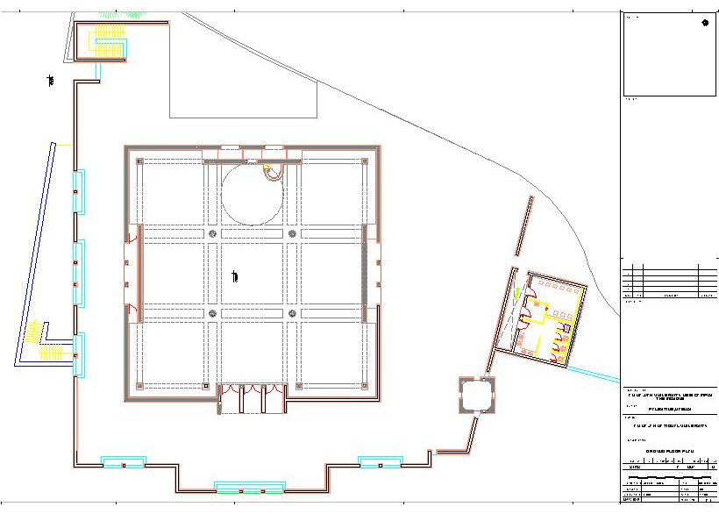

Slide 5
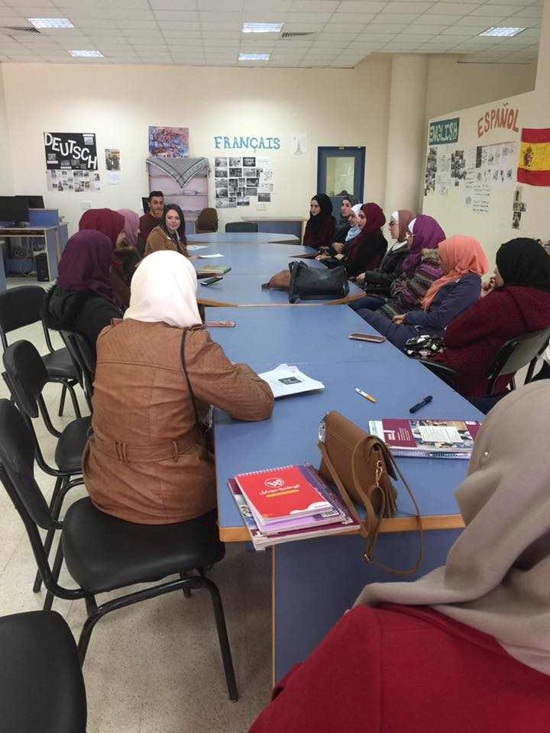
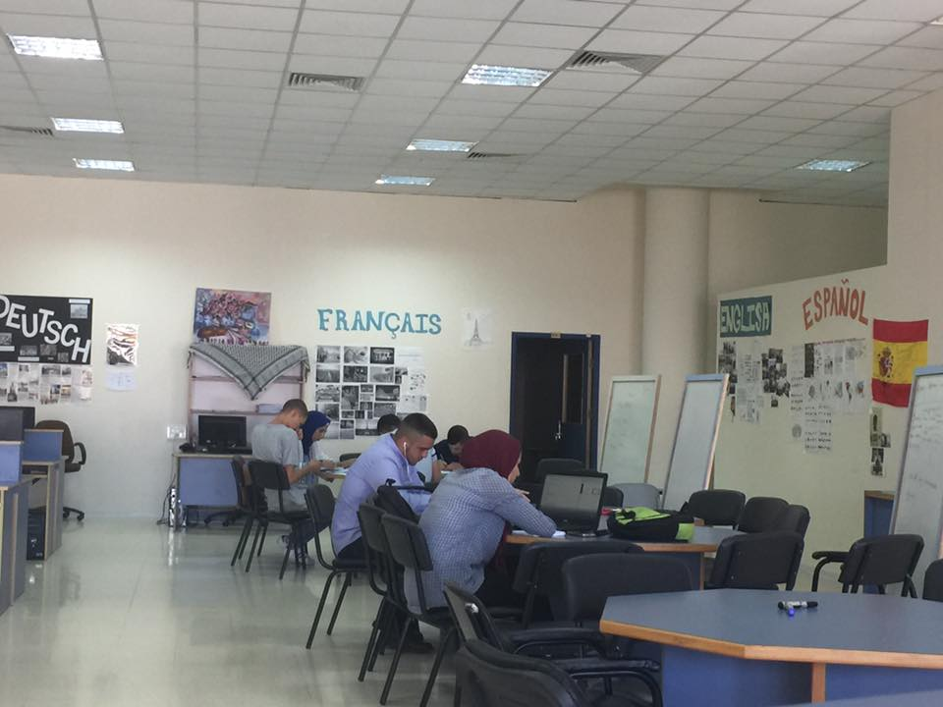
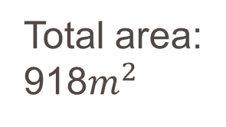
Basement one: language and rescore center.
Total area:
918$m^{2}$

Slide 6
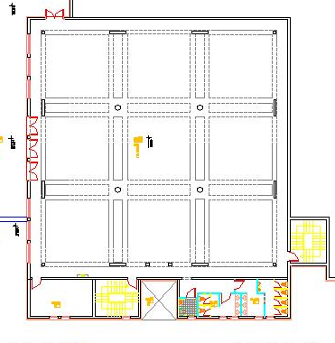

Slide 7
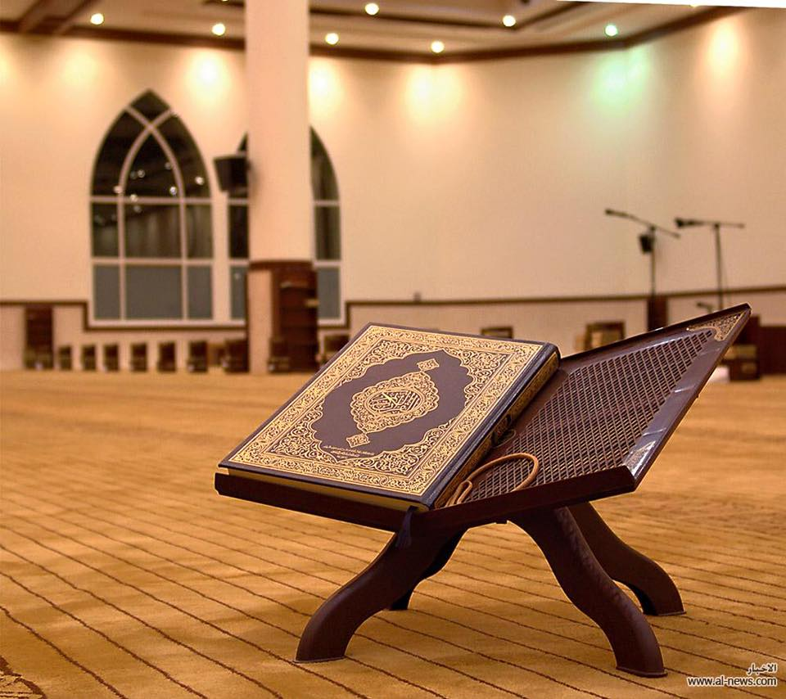
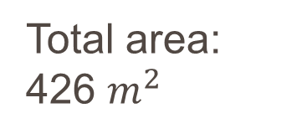
Basement two: Female mosque.
Total area:
426 $m^{2}$

Slide 8
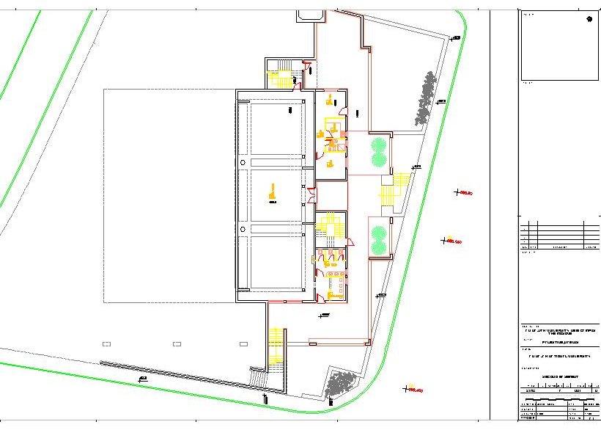

Slide 9
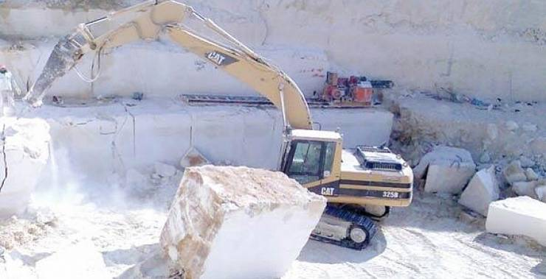
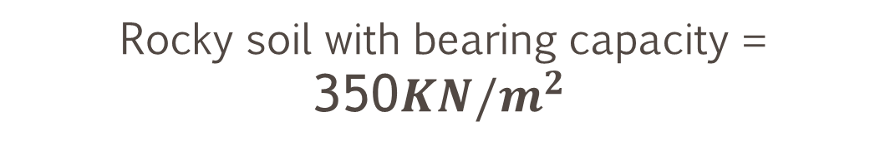
Site and geology
Rocky soil with bearing capacity = 350${KN/m}^{2}$

Slide 10



Codes and standards
ACI 318-12
IBC 2009
ASCE7-10 code

Slide 11
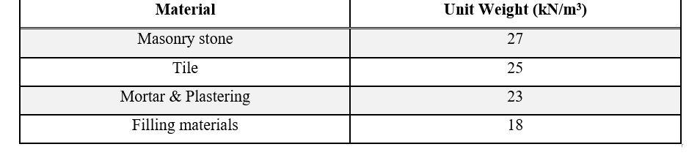
Materials
Concreate 28 Mpa Grade-60 Steel
F_{y} is 420 MPa
Finishing materials and its unit weight

Slide 12
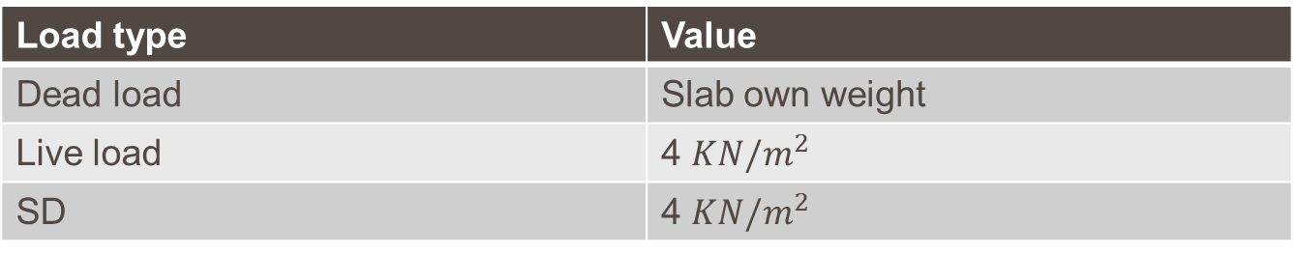
Static Loading
Slab loads:
Load type | Value
Dead load | Slab own weight
Live load | 4 ${KN/m}^{2}$
SD | 4 ${KN/m}^{2}$
Wall additional weight:
3.2 kN/m² (Masonry stone from one side)
6.5 kN/m² (Masonry stone from two sides).

Slide 13
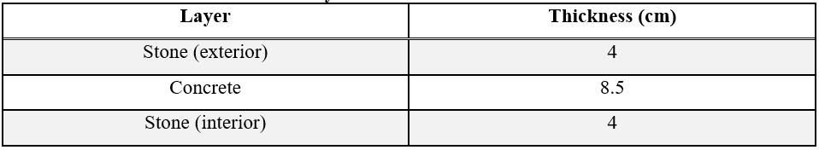
Static Loading
Shear wall loads:
Layers thickness in the wall section

Slide 14

PRELIMINARY CALCULATIONS
  Slab thickness
$\text{∝}$_{fm} > 2.
Slab thickness > 90mm.
$$h_{slab}=\frac{L_{n}(0.8+\frac{F_{y}}{1400})}{36+9β}$$
h= 0.163m, try h=0.2m.
$∝_{f}=18.6.$
$\text{∝}$_{fm} =$\frac{18.6×4}{4}=18.6>2$ ok.

Slide 15

Beam size
$$Wu=1.2(OW+SD)+1.6×LL$$
$Wu=1.2\left(0.2×25+4\right)+1.6×4.5=18k$KN/m²
$$Wu=18×6.7=120.6kN/m$$
$Wu$=$121kN/m$
Moment on the critical beam is:
$Mu=\frac{Wu×{Ln}^{2}}{8}=\frac{120.6×{6.7}^{2}}{8}=677kN$.m
Let beam width (b) = 0.5m & beam depth (h) = 1m.
$ρ=4.6×{10}^{−3} ρ>ρ_{min}$ Ok.

Slide 16
Column Size
Ultimate loads & approximate capacity of column sections
Section | Ultimate load ( kN/m²) | Approximate capacity ( kN/m²)
70cm diameter (circular) | 2515 | 3850
(40×40)cm (rectangular) | 277 | 1600
(25×175)cm (rectangular) | 2090 | 4375
(35×85)cm (rectangular) | 1141 | 2975

Slide 17

Dome thickness & ring beam dimensions
Dead load (g) = 0.12*25 = 3 kN\m² , Radius (R) =3.45m , Thickness (T) = 0.12m
Live load (q) =2 kN\m2 , Semi-sphere (ϴ) =90º.
For dead load:
N⦶ $=\frac{gR}{1+\cos{∅}}$
N_{ϴ=}$gR(\cos{∅}− \frac{1}{1+\cos{∅}})$
For live load:
N_{⦶ =}$\frac{qR}{2}$
N_{ϴ} =₌$\frac{qR}{2} \cos{2∅}$

Slide 18
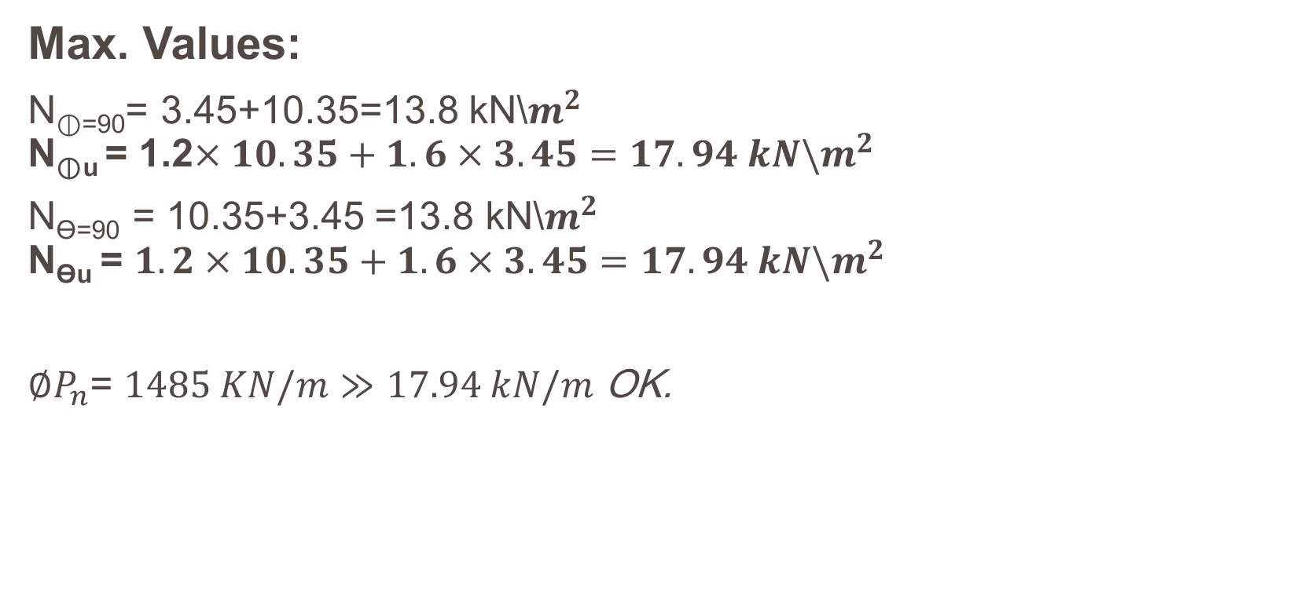
Max. Values:
N_{⦶=90}= 3.45+10.35=13.8 kN\$m^{2}$
N_{⦶u} = 1.2$×10.35+1.6×3.45=17.94 kN\backslash m^{2}$
N_{ϴ=90} = 10.35+3.45 =13.8 kN\$m^{2}$
N_{ϴu} = $1.2×10.35+1.6×3.45=17.94 kN\backslash m^{2}$
$∅P_{n}$= $1485 KN/m≫17.94 kN/m$ OK.

Slide 19
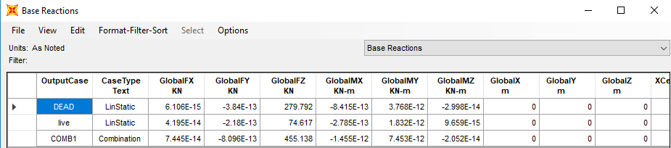
Ring beam dimensions
Let choose beam depth (h) =1m, width (b) of 0.3m.
Base reaction in Z direction for the dome is 455 kN.
Base reaction for the ring beam

Slide 20


Perimeter of the ring beam is 6.9*4m = 27.6m.
Load on the ring beam is 16.5 kN/m to the gravity.
$ρ$ = 0.0011 < $ρ_{min}$ Ok. Use${ ρ}_{min}$.

Slide 21

Minaret of the Mosque
Ultimate load $=4920 kN$
For each column =$4920÷4 =1230 kN$
Column capacity ≈ it's area in cm².
=$150×40+100×40$ =10000 kN. OK

Slide 22
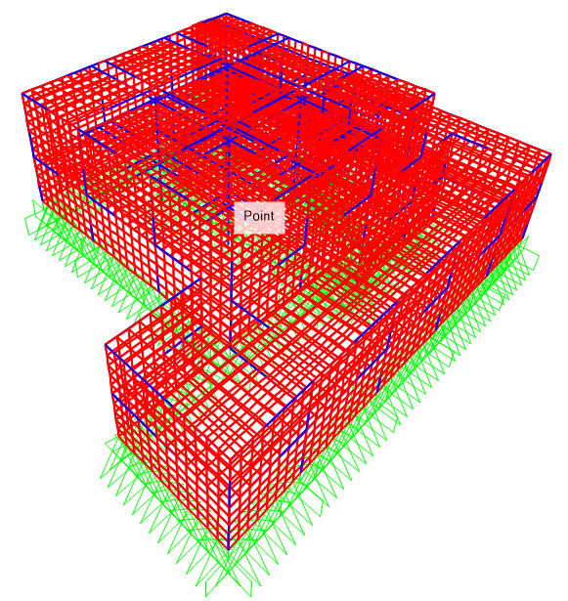
3-D MODEL & CHECKS

Slide 23
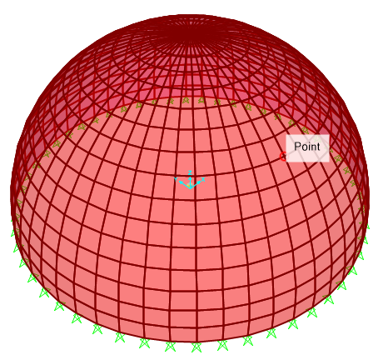
3-D model of the dome

Slide 24
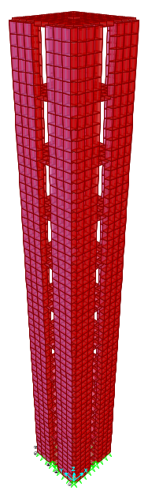
3-D model of the minaret

Slide 25
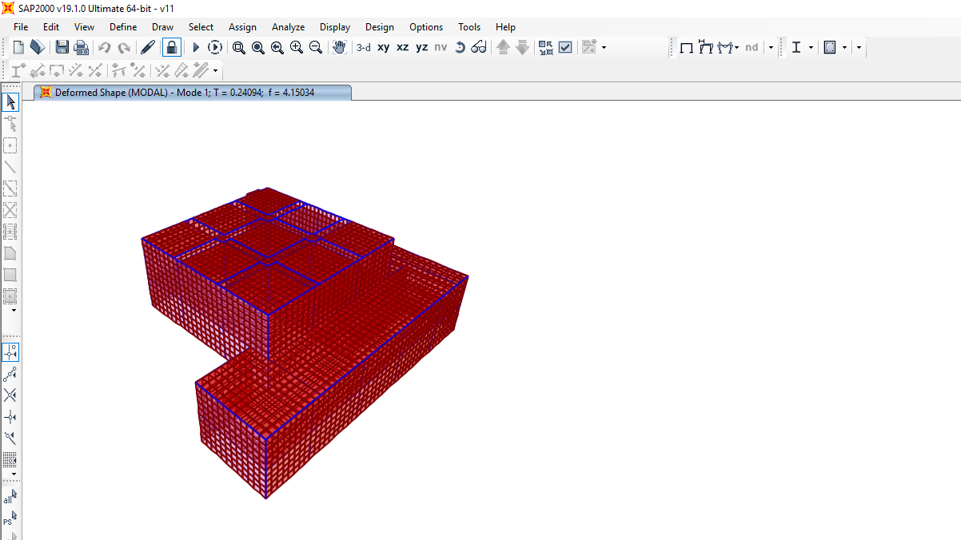
Compatibility checks

Slide 26
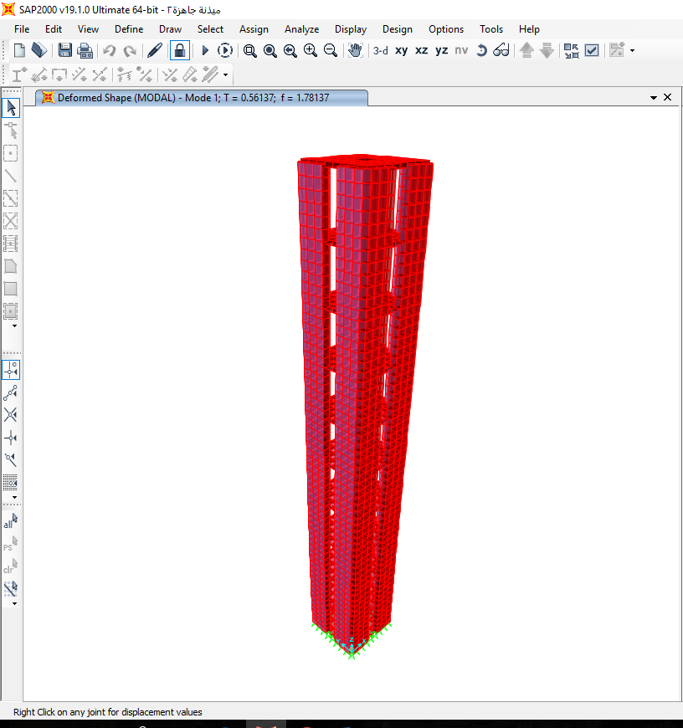
Compatibility checks

Slide 27
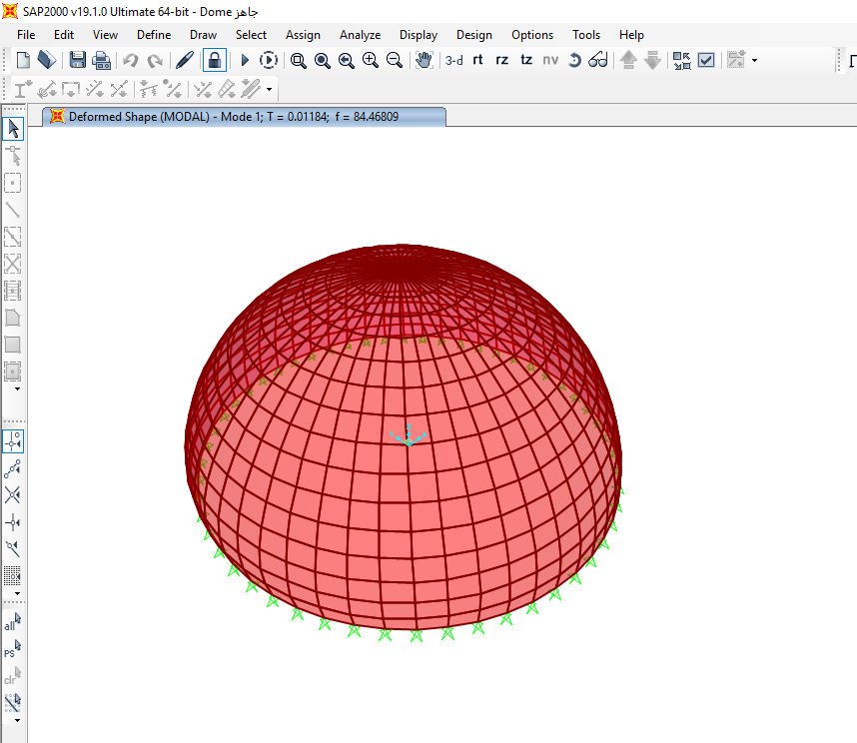
Compatibility checks

Slide 28
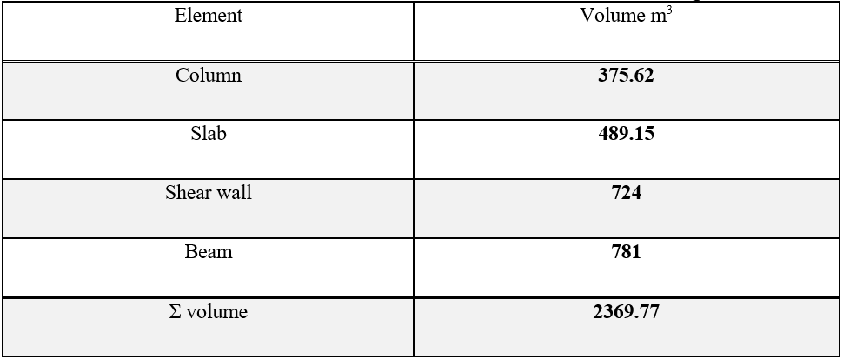
Equilibrium check
Main structure
Hand calculations
Total volume of the structural elements of the building

Slide 29
Equilibrium check
Dome load =1144.8 kN.
Concrete weight = 2369.77×25 = 59244.25 kN.
Total dead load = concrete weight + dome load
DL =59244.25 +1144.8 = 60389.05 kN
SAP2000 result:
Error% = $\frac{62628.897 −60389.05 }{62628.897} ×100\%$ = 3.6% < 5% Ok

Slide 30
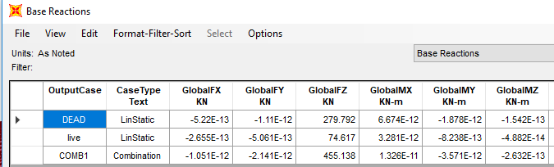

Equilibrium check
Dome
Hand calculation:
Reaction from dead load = 280KN
Error% = $\frac{280−279.792}{280} ×100\%$ = 0.07% < 5% Ok.
SAP2000 results:

Slide 31
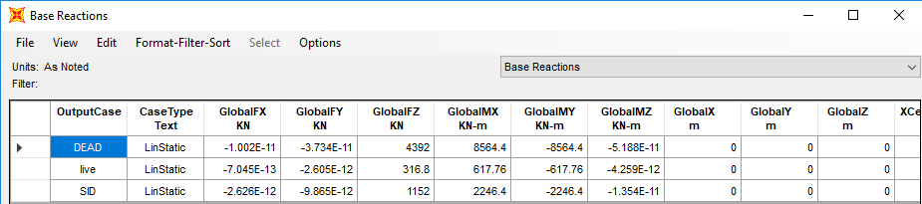

Equilibrium check
Minaret
Hand calculation:
Reaction from dead load = 4392 KN
Error% = $\frac{4392−4392}{4392} ×100\%$ = 0% < 5% Ok.
SAP2000 result:

Slide 32

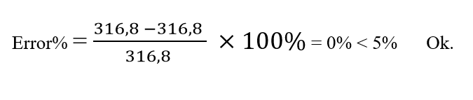
Base reaction from live load
Hand calculation:
R=2×(3.9×3.9-0.9×0.9)×11= 316.8 kN
From SAP2000

Slide 33

Base reaction from Supper imposed load
Hand calculation:
R=1.5×8×30×3.2= 1152 kN
From SAP2000

Slide 34
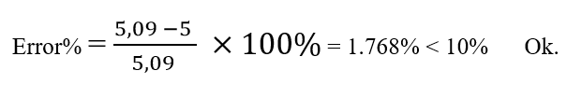

Stress-Strain relationship check
Fawzi
Moment
Hand calculation:
$$M= \frac{2×{3.35}^{2}×3.35/2}{8}=5kN∙m$$
SAP2000 results:
$M$ = $5.09kN∙m$

Slide 35
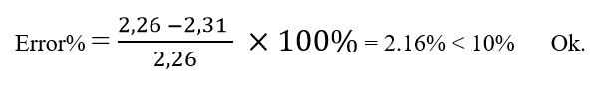

Stress-Strain relationship check
Shear in slab
Hand calculation:
$V=\frac{2∗3.35}{2}−0.17∗2−0.7∗.5∗2=2.31 kN$/m
SAP2000 result: 2$.26kN$/m

Slide 36
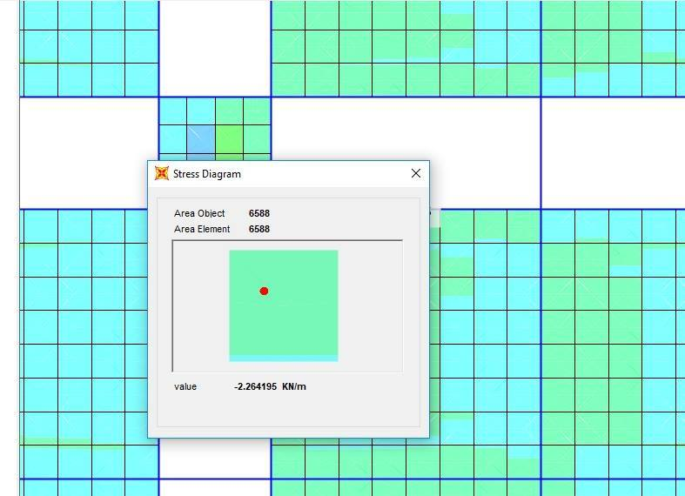
SAP2000 result:
Shear value due to live load

Slide 37
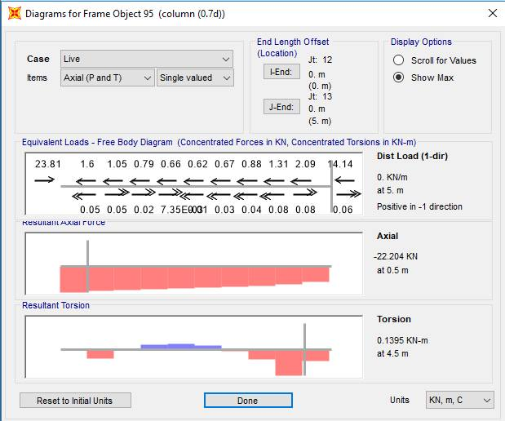

    Axial load
SAP2000:
Hand calculation
$$P_{n}=\frac{3.35}{2}∗\frac{3.35}{2}∗4∗2=22.445 kN$$
Error% = $\frac{22.294 −22.445 }{22.294} ×100\%$ = 1.07% < 10% Ok.

Slide 38
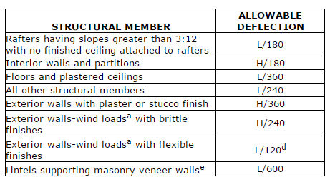
Deflection
Allowable deflection criteria

Slide 39
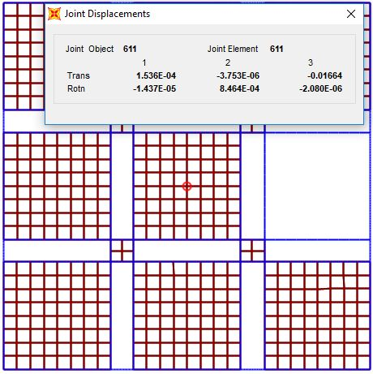
Deflection check
Allowable deflection:
U₃=7.2/240 = 0.03m
Immediate deflection : 0.0193 m .
Long term deflection : 0.0216 m.
SAP2000 result: 0.01664m

Slide 40
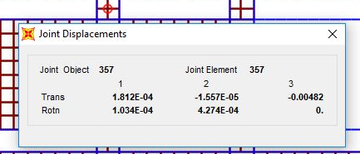
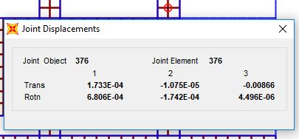
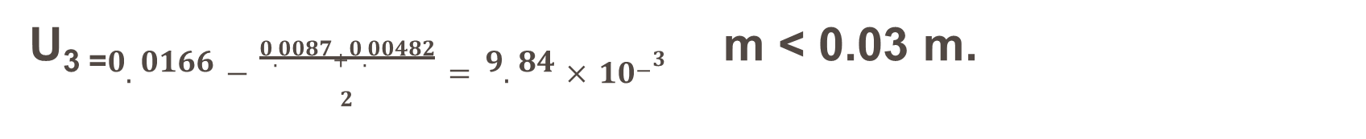
Deflection in the exterior columns
U₃ ₌$0.0166−\frac{0.0087+0.00482}{2}=9.84×{10}^{−3}$m < 0.03 m.

Slide 41
Statical DESIGN & DETAILING

Slide 42
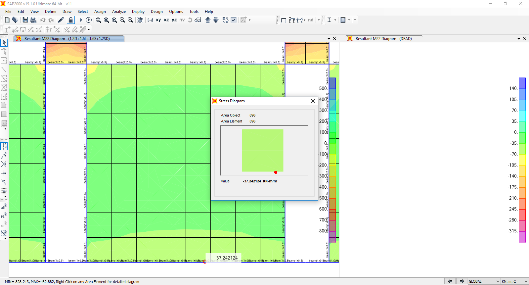
DESIGN & DETAILING
  For slab:
The result is: 37 KN.m

Slide 43
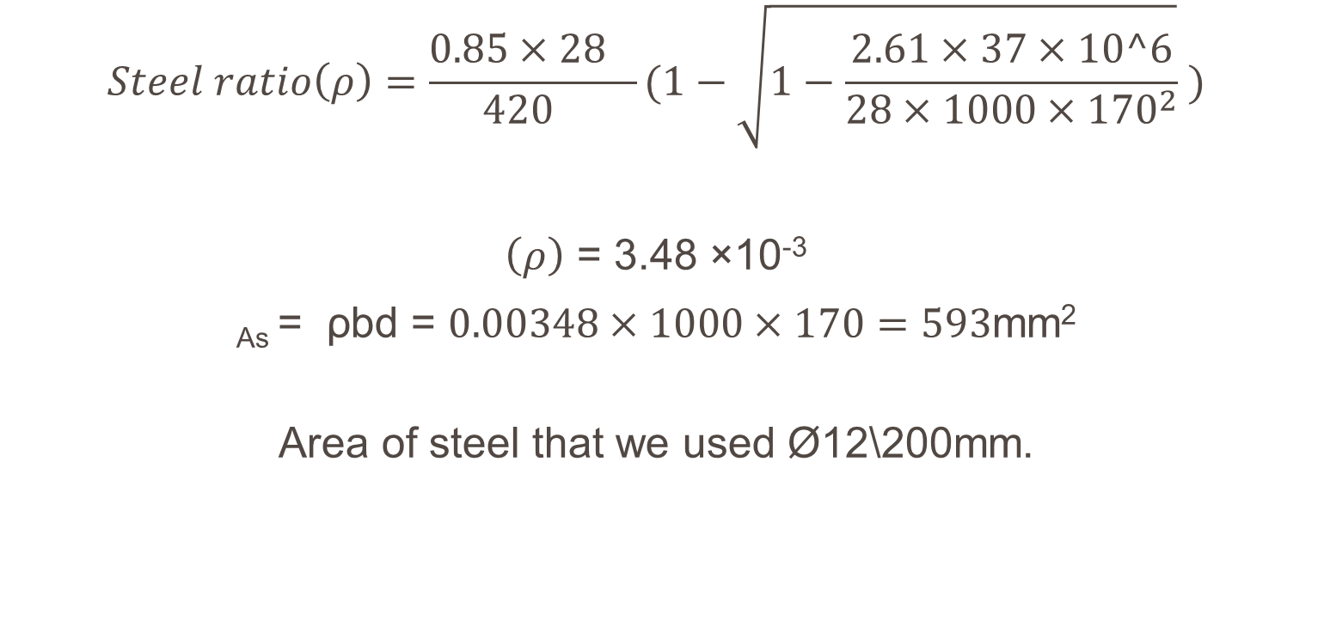
Steel reinforcement for slab
$$Steel ratio\left(ρ\right)=\frac{0.85×{28}_{}}{{420}_{}}(1−\sqrt{1−\frac{2.61×37×10^6}{28×1000×{170}^{2}}} )$$
$\left(ρ\right)$ = 3.48 ×10⁻³
_{As} = ρbd = $0.00348×1000×170=593$mm²
Area of steel that we used Ø12\200mm.

Slide 44

Slab detailing

Slide 45

Beam(0.5*2.5) internal moment (static)
Mu=660KN.m

Slide 46

Beams
Beams reinforcement:

Slide 47


Beams detailing
Beam 0.5*1
Beam 0.5*2.5

Slide 48

Columns design

Slide 49




Columns detailing

Slide 50


Minaret:
Minaret slab:
Mu = 10.6KN.m
Minaret slab detailing:

Slide 51

Minaret walls detailing

Slide 52

Dome detailing

Slide 53

Panel
Maximum moment
Mu = 3371 KN.m

Slide 54

Panel detailing

Slide 55

Dynamic analysis
Aref

Slide 56

Location classification zone

Slide 57

Site soil classification

Slide 58

Fa & Fv based on site soil classification

Slide 59
Fa & Fv based on site soil classification
Z=0.2 g
site class = B
S1=1.25*Z=0.25
Ss=2.5 Z =0.5
Fa = 1
Fv = 1
SDs = (2/3) X SMs = 2/3 *Fa*Ss =2/3*1*0.5 = 0.334 SD1 =2/3* SM1 = 2/3 *Fv*S1 = 2/3 *1*0.25 = 0.167

Slide 60

Occupancy type

Slide 61

Importance factor

Slide 62

Seismic design category

Slide 63

Period calculations

Slide 64

Period calculations

Slide 65
Equivalent Static Force using SAP2000
Vx from SAP2000 = 7839 kN
Vy from SAP2000 = 7839 kN

Slide 66

Ultimate load combinations

Slide 67

DYNAMIC DESIGN & DETAILING

Slide 68

FOOTINGS & COLUMN CENTERLINES
BASMENT 2

Slide 69

FOOTINGS & COLUMN CENTERLINES
BASMENT 2

Slide 70

FOOTINGS & COLUMN CENTERLINES
BASMENT 1

Slide 71

FOOTINGS & COLUMN CENTERLINES
GROUND FLOOR

Slide 72

FOOTINGS DETALING

Slide 73

FOOTINGS DETALING

Slide 74

FOOTINGS DETALING

Slide 75

FOOTINGS DETALING

Slide 76

FOOTINGS DETALING

Slide 77

FOOTINGS DETALING

Slide 78

FOOTINGS DETALING

Slide 79



SLAB DETALING
Mu = 55.5 KN.m/m

Slide 80


SLAB DETALING

Slide 81

BAEMS DESIGHN & DETALING

Slide 82

BEAM (1X0.5)

Slide 83

BEAM (2.5X0.5)

Slide 84

COLUMNS DESIGHN & DETAILNG

Slide 85

COLUMNS DESIGHN & DETAILNG
C1 (0.7m diameter)

Slide 86

COLUMNS DESIGHN & DETAILNG
C2 (1.75X0.25m)

Slide 87

COLUMNS DESIGHN & DETAILNG
C3 (0.4X0.4m)

Slide 88



COLUMNS DESIGHN & DETAILNG
C4 (0.85X0.35m)

Slide 89


COLUMNS DESIGHN & DETAILNG
C5 (0.5X0.3m)

Slide 90

COLUMNS DESIGHN & DETAILNG

Slide 91

PANEL DETALING

Slide 92

PANEL DETALING

Slide 93


PANEL DETALING

Slide 94


PANEL DETALING

Slide 95
THANK YOU

